Slide 1
iPhone Forensics
Digital Forensics, Day 2

Slide 2
Class Objectives
By the end of class today, students will be able to:
Identify the methods used in smartphone forensics.
Describe databases and file structures of iPhone’s flash drive.
Locate identifiable evidence on the iPhone that established ownership.
Use Autopsy to view and tag evidence in an iPhone image.
Extract image content for use in other applications (logs, text, pictures video, audio).

Slide 3
Warm Up Activity
In this activity, you will review the steps for creating a new case and ingesting an image file. You will also learn how to find and display a file without using the Directory Tree.
Instructions sent via Slack.
20 minutes

Slide 4
Autopsy Main Pains
File Metadata
Displaying Text
File Search

Slide 5
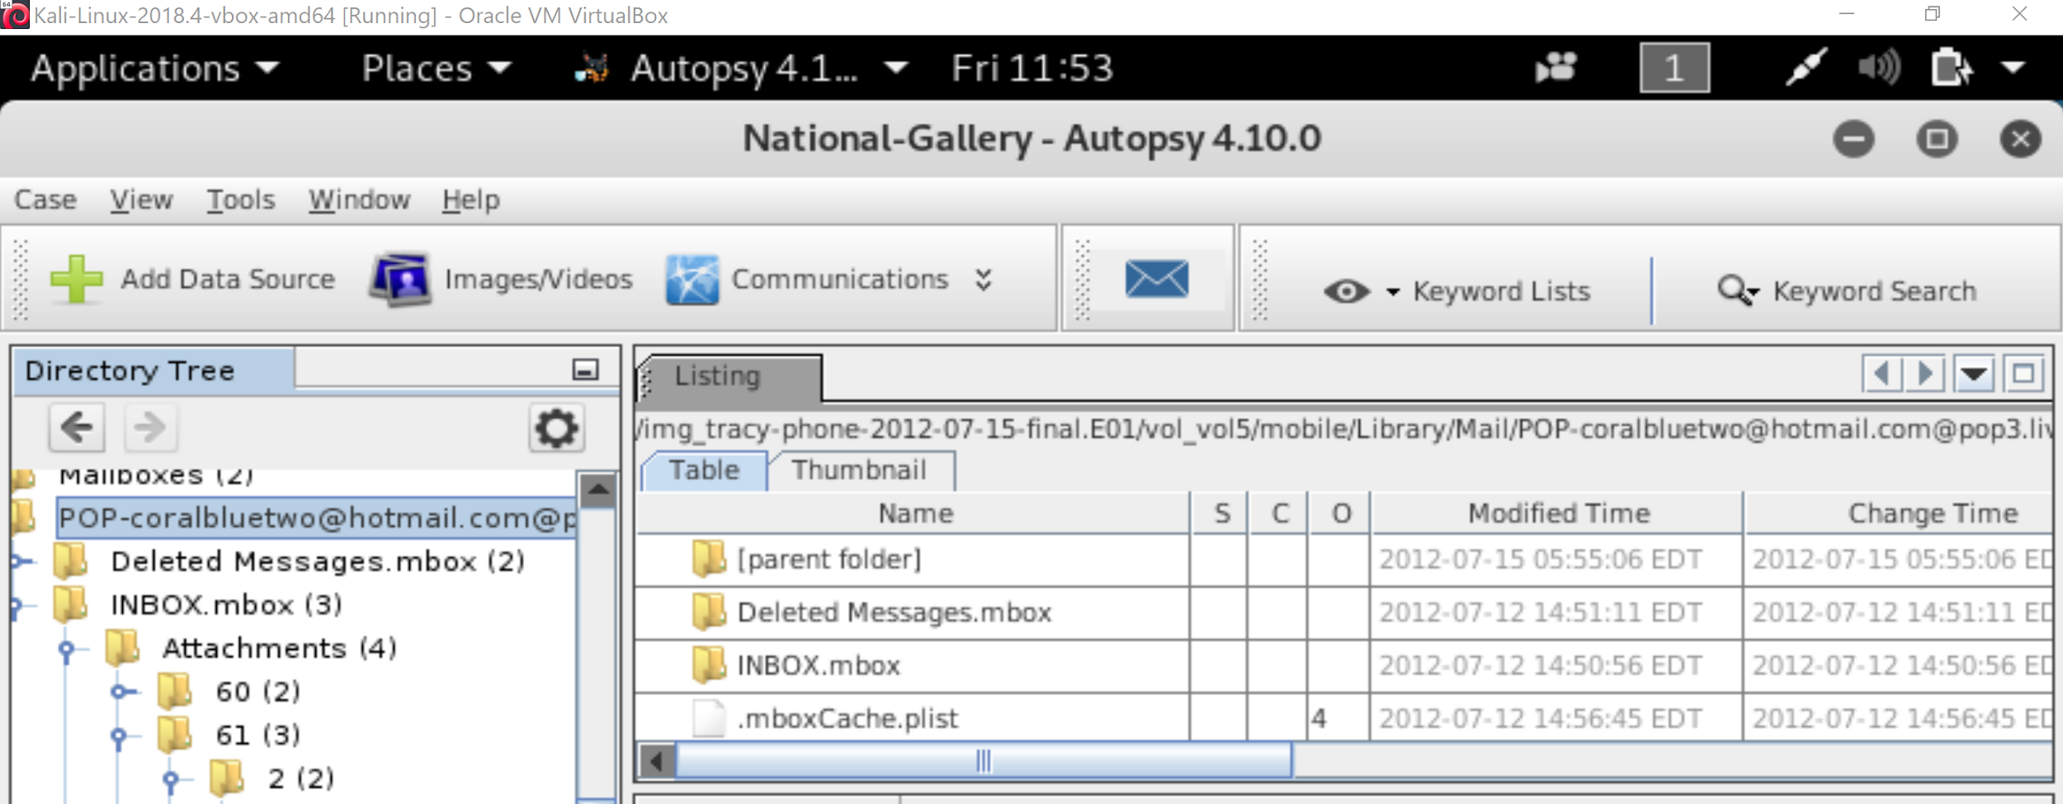
Review: How to View Text and Metadata using an Iphone Image
The main panes in the user interface: Directory Tree, Listing, and Data Content

Slide 6
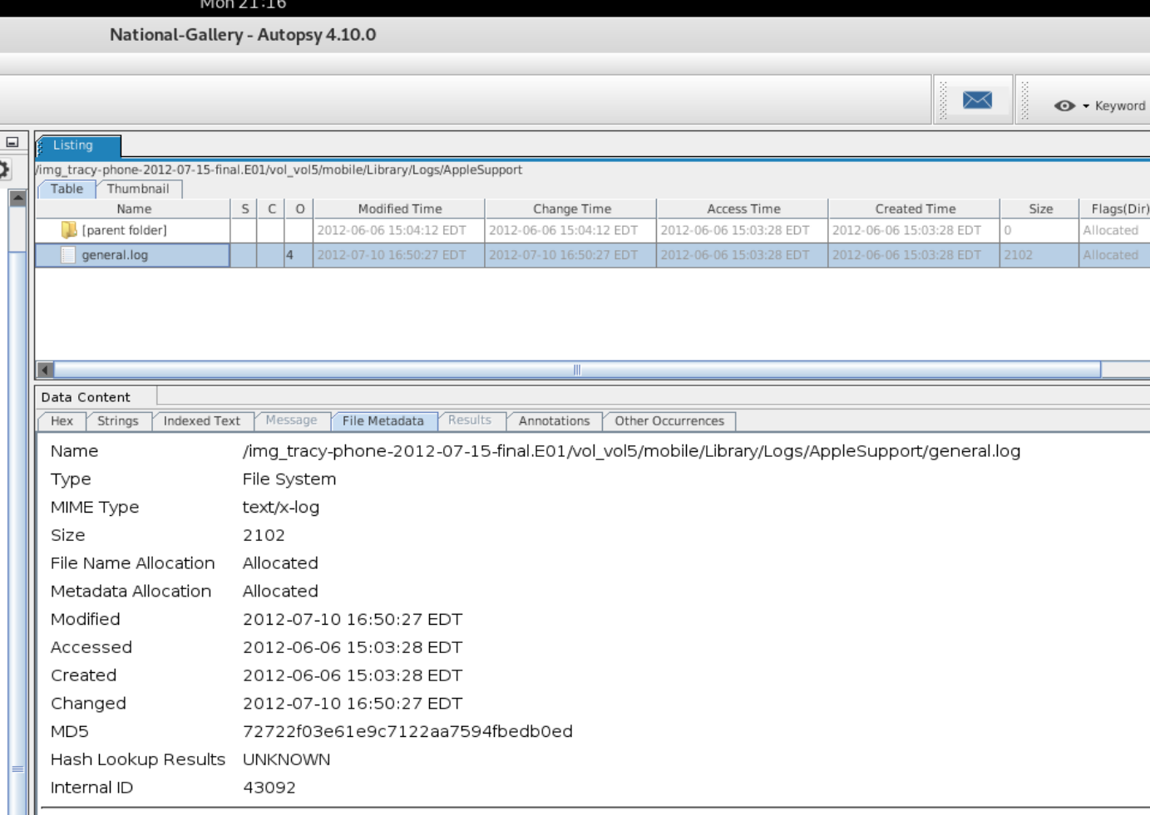
Review: How to View Text and Metadata using an Iphone Image
Capturing file metadata using the File Metadata tab in the Data Content pane reveals the location in the image (Name), mime type, size, creation date, and md5 hash

Slide 7
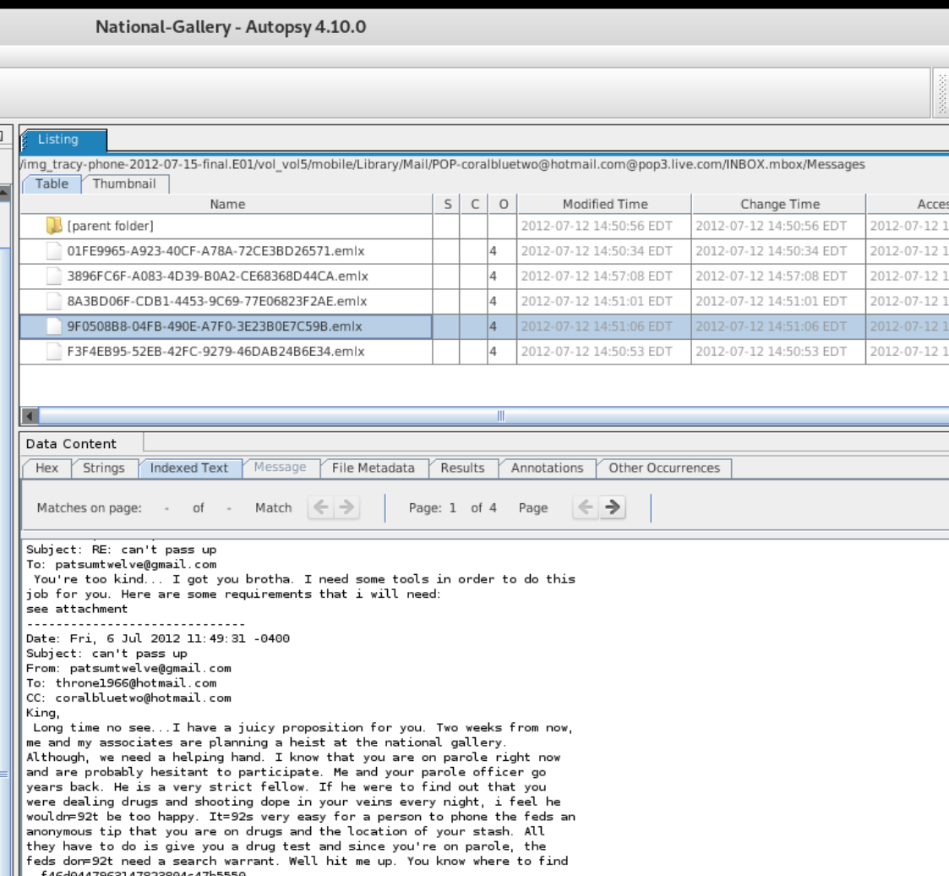
Review: How to View Text and Metadata using an Iphone Image
The Indexed Text tab is used to display text in the image in a human readable format.

Slide 8
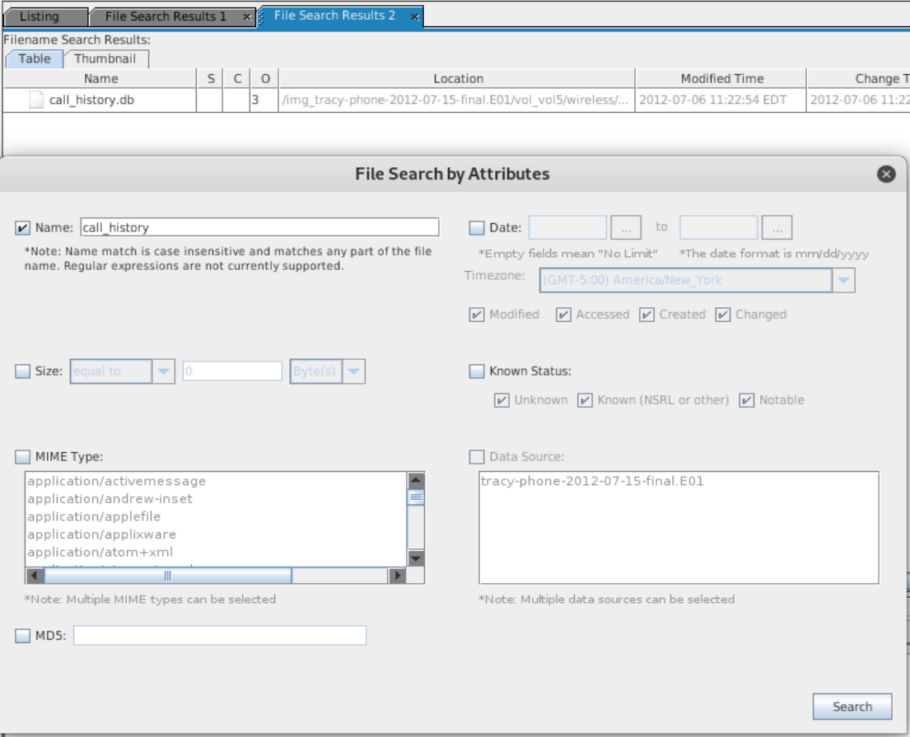
Review: How to View Text and Metadata using an Iphone Image
If you know the file name, searching for a file in the iPhone image is faster than using the Directory Tree.

Slide 9
Introduction to iPhone Forensics

Slide 10

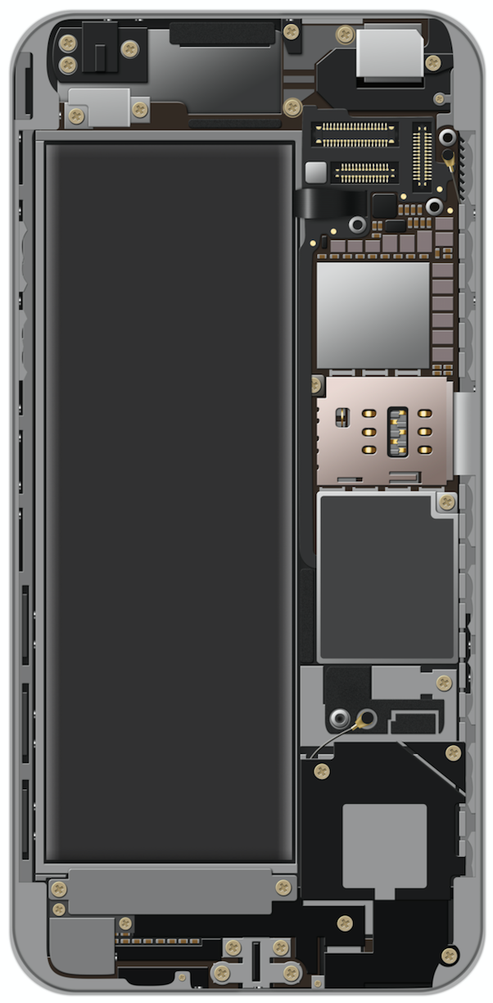
iPhone, an introduction
First released in June of 2007
Runs on iOS operating system
Currently 700 million iPhones in use (compared to 2.3 billion Android phones.)
The phone data is encrypted and has been involved in several high profile forensic cases
Notes:
Phone AdobeStock ID 105140326

Slide 11

Where’s the Data? File systems and Data Storage
It is important to know where data is stores, how to access it, and how to recover it.
Instead of external storage, iPhones uses flash memory.
Contains two disk partitions:
Root partition used for operating systems and applications
Var partition used for data
Remember: Data is first imaged using bit-level-copy.
iPhone texts, GPS coordinates, cell tower locations can
all be recovered.
Notes:
Phone AdobeStock ID 105140326

Slide 12

Important Directories, Databases, and Files
For our investigation, the following directories contain evidence for investigations:
/mobile, /Applications, /Library, /root, /Logs, /logs
Remember, iOS is based on Unix… Navigating the directory structure should be familiar territory.*
*Not actually a Steve Jobs quote.
Notes:
Shutterstock ID: 673169044

Slide 13

Important Directories, Databases and Files
iPhone users store data in SQL databases and other files.
SQL (System Query Language) is a programming language used to read, write, and update database files.
Databases are used to store information. For example: an address book.

Slide 14
Important Directories / Databases, and Files
Name:
Contents:
AddressBook.sqlitedb
Contact info, personal data like name, email address, etc.
AddressBookImages.sqlitedb
Images associated with saved contacts
Calendar.sqlitedb
Calendar details and events information
CallHistory.db
Call logs including phone numbers and timestamps
sms.db
Text and multimedia messages along with timestamps
voicemail.db
Voicemail messages
Safari/Bookmarks
Saved URL addresses
Envelope Index
Email addresses on phone
consolidated.db
GPS tracking data
locationd
Google coordinates of places

Slide 15
Important Directories / Databases, and Files
iPhone also has data stored in Property Lists (plists)
plists store configuration information, call history and cache information
Maps/History.plist tracks location searches
Map/Bookmarks.plist contains bookmarks
Safari/History contains internet browsing history

Slide 16
Is this Tracy’s iPhone?

Slide 17
Activity: Is this Tracy’s iPhone?
In this activity, you will analyze the contents of Tracy's iPhone image in order to begin establishing your case.
Instructions sent via Slack.
20 Minutes

Slide 18
Is this Tracy’s iPhone?

Slide 19
Is this Tracy’s iPhone? Review
 | Findings | Location in iPhone Image
Device Model | iPhone1.2 | vol/5/mobile/Library/Logs/AppleSupport/general.log
Device Serial Number | 86004482Y7H | vol/5/mobile/Library/Logs/AppleSupport/general.log
OS Version Number | 4.2.1 | vol/5/mobile/Library/Logs/AppleSupport/general.log
Installation Timestamp | 7/10/2012 16:50:27 | vol/5/mobile/Library/Logs/AppleSupport/general.log
Email Address | tracy.sumtwelve@nationalgallerydc.org, tracysumtwelve@gmail.com, coralbluetwo@gmail.com | vol/5/mobile/Library/Mail
Phone Number | 703-340-9661 | Indexed Text: vol5/logs/lockdown.log.1 set_formated_phone_ numbe: New phone number 1 (703) 340-9661 to insert into the ark
ICCID | 89014103255195342366 | vol/logs/lockdown.log.1

Slide 20
Is this Tracy’s iPhone? Review
How are the IMEI and ICCD are used to establish device identification?
The International Mobile Equipment Identification (IMEI) is a unique 15-17 digit code stored on the back of the phone used to validate device identification.
The Integrated Circuit Card ID is the unique identifier of a Subscriber Identity Module (SIM card) on a mobile device.

Slide 22
Tagging Evidence

Slide 23
Autopsy includes a tag evidence feature, allowing investigators to find information easier.
Pre-defined tags include:
Follow Up, Notable, and Child Exploitation.

Slide 24
Adding a Bookmark
How to bookmark the SMS database...

Slide 25
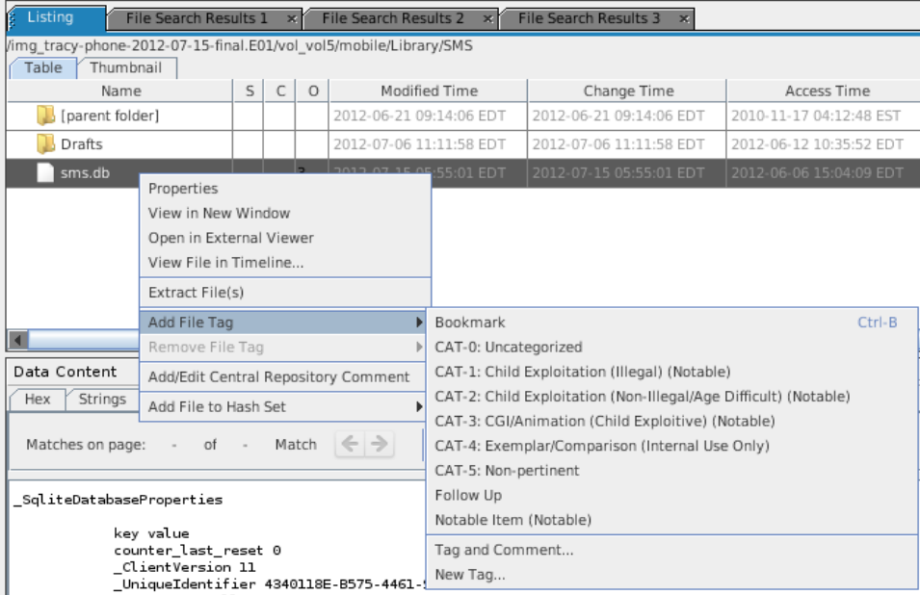
Bookmarking the SMS Database
Locate the sms.db file in the iPhone image using the Tools->Files Search by Attributes.
Click on the sms.db entry in the Listings pane.
Right-click and select Add Tag -> Bookmark.
A yellow upside-down triangle will appear next to the sms.db entry in the Listing pane.
The bookmarked entry can be found in the Directory Tree under Tags.

Slide 26
Adding a New Tag to the Tag database
How to create a new tag in the database...

Slide 27
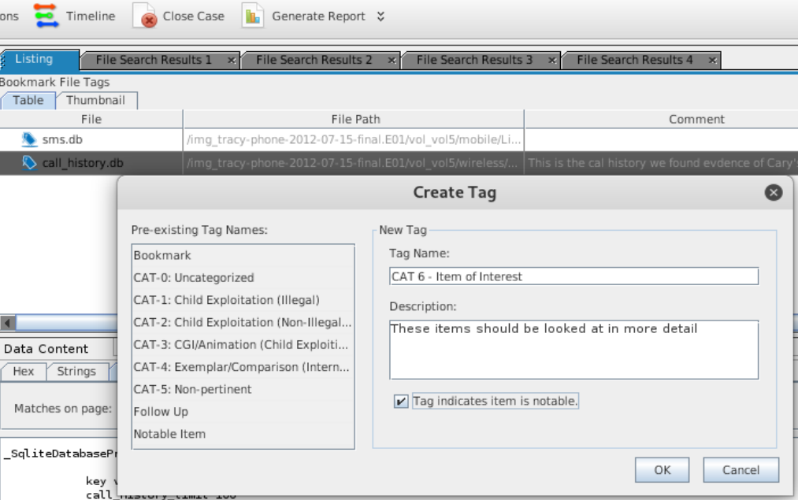
Creating a new tag to the database
A company may have a tagging scheme that can be used in Autopsy.
Right-click and select Add Tag -> New Tag.
The Create Tag window is displayed to add a new tag and comment.
The new tag entry can be found in the Directory Tree under Tags

Slide 28
Activity: Tagging Evidence
In this activity, you will tag the major Database and Files in the iPhone image file
Instructions sent via Slack.
10 Minutes

Slide 29
Tagging Evidence

Slide 30
Extracting Data
for Offline Analysis

Slide 31
Extracting Data for Offline Analysis
Some investigators may extract the entire directory tree for offline viewing, which facilitates viewing videos and pictures.
Viewing videos and pictures is a much easier process with offline extraction.
Not all data can be viewed in a text editor.
The databases are viewed using SQLite or any SQL software.
In the next demo, we’ll demo how to extract a file or an entire directory for viewing within Kali Linux and other operating systems.

Slide 32
Exporting One File
How to export a single file

Slide 33
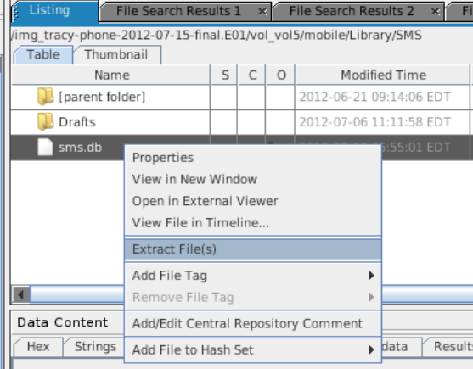
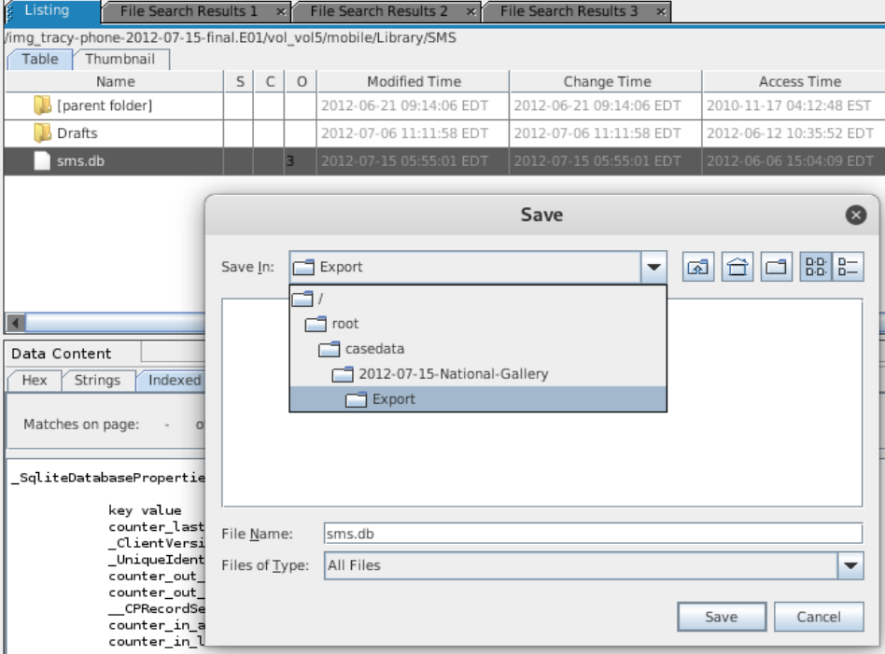
Exporting a Single File
Select the sms.db database. Right-click and select Export Files
By default, the files are placed in the Export directory for the case.
Export directory is located in the casedata directory.
This file can only be viewed with a SQL application

Slide 34
Exporting An Entire Directory
Exporting an entire directory and viewing it in Kali

Slide 35
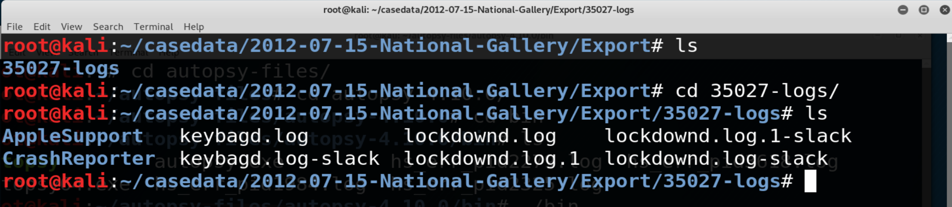
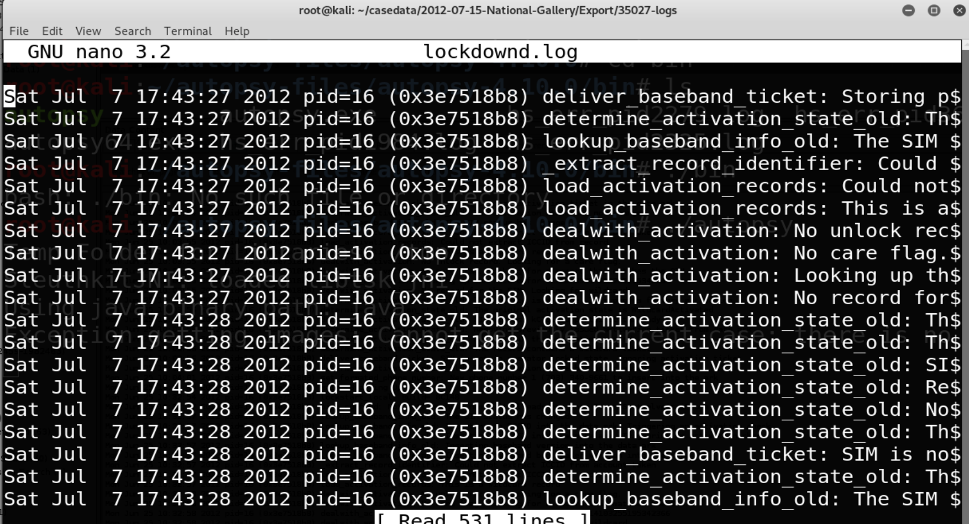
Exporting an entire directory
Select the vol5/logs directory in the Directory Tree pane.
Right-click and select Export Files, and export the entire directory to the Export directory in Kali.
Navigate to the Export directory
Open a new terminal window and navigate to the Export directory that contains the extracted directory. (Image 1)
View the lockdownd.log file in the nano editor. (image 2)

Slide 36
Activity: Extracting Data for Offline Analysis
In this activity you will practice exporting a single file and an entire directory for offline analysis.
Instructions sent via Slack.
10 minutes

Slide 37
Exporting for Offline Analysis

Slide 38
Class Objectives
By the end of class today, students will be able to:
Identify the methods used in smartphone forensics.
Describe databases and file structures of iPhone’s flash drive.
Locate identifiable evidence on the iPhone that established ownership.
Use Autopsy to view and tag evidence in an iPhone image.
Extract image content for use in other applications (logs, text, pictures video, audio).

